Slide 1




Regular Expressions
/^Hel{2}o\s*World\n$/
JavaScript
Basics
SoftUni Team
Technical Trainers
Software University
http://softuni.bg

Slide 2

Table of Contents
Regular Expressions
Characters
Operators
Constructs
Regular Expressions in JavaScript
Helpful Resources

Slide 3
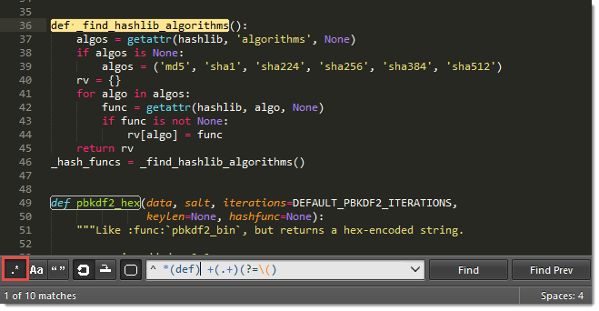
Regular Expressions

Slide 4

Regular Expressions
A regular expression is a sequence of characters that forms a search pattern
Also known as regex, regexp, rational expression
Used for finding and matching certain parts of strings
E.g. all uses of the word "regex"
All strings that correspond to the expression (also known as pattern) are matched
For example A\w+ matches all words in a text
that start with A

Slide 5
Search Patterns
Search patterns describe what should be matched
For example, is read as:
Starts with the literal +
Followed by 359
Followed by 9 symbols from in the range 0…9
\+359[0-9]{9}
+61948228831222 – Dick
+359882021853 – Tanio
+2394818322 – Chai Pyong
+9738418 2838 – Nashmat
+359896923312 – Pesho

Slide 6

Regular Expression Syntax

Slide 7

Character Escapes

Slide 8
Character Escapes
Character | Description | Example
\t | Matches a tab
\n | Matches a new line
\u0000 | Matches a Unicode character (e.g. \u0065 is lowercase e)
\ | Matches a literal character (e.g. \. matches a dot .)
This is SPARTA!
The quick brown fox
jumped over
the lazy dog.
Eloquent elf
Interesting. Will look into.

Slide 9
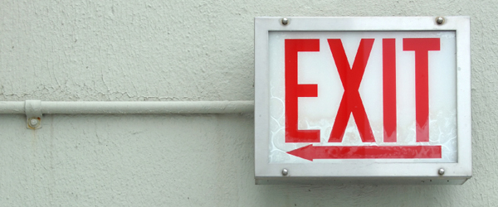
Character Escapes
Live Demo

Slide 10

Character Classes

Slide 11
Character Classes
[character_group] - Matches any single character in character_group
E.g. [nvj] matches any character that is either n, v or j
[^character_group] - Negation: Matches any single character that is not in character_group
E.g. [^abc] – matches any character that is not a, b or c
node.js v0.12.2
Abraham Lincoln

Slide 12
Character Classes (2)
[first-last] - Character range: Matches any single character in the range from first to last
E.g. [0-9] matches any digit frm 0 to 9
. - Matches any single character except \n
In 1519 Leonardo da Vinci died at the age of 67.
Dot matches everything except new line.

Slide 13
Character Classes (3)
\w – Matches any word character (a-z, A-Z, 0-9, _)
\W – Matches any non-word character (the opposite of \w)
\s – Matches any white-space character
\S – Matches any non-white-space character (opposite of \s)
\d – Matches any decimal digit
\D – Matches any non-digit character (opposite of \d)
aBcd 09_ &*^ Ю-Я
aBcd 09_ &*^ Ю-Я

Slide 14
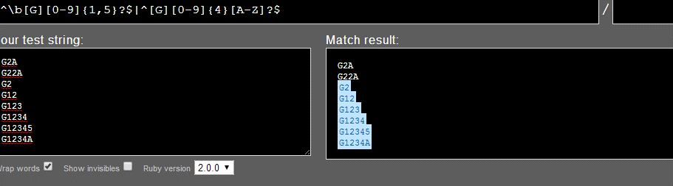
Character Classes
Live Demo

Slide 15

Quantifiers

Slide 16
Quantifiers
* - Matches the previous element zero or more times
+ - Matches the previous element one or more times
? - Matches the previous element zero or one time
+359885976002
+
\+\d*
=>
+359885976002
+
\+\d+
=>
\+\d?
=>
+359885976002
+

Slide 17
Quantifiers (2)
{n} - Matches the previous element exactly n times
{n,} - Matches the previous element at least n times
{n,m} - Matches the previous element at least n times, but no more than m times
\+\d{5}
=>
+359885976002
\+\d{5,}
=>
+359885976002
\+\d{5,7}
=>
+359885976002

Slide 18

Quantifiers
Live Demo

Slide 19
Anchors

Slide 20

Anchors
^ - The match must start at the beginning of the string or line
$ - The match must occur at the end of the string or before \n
Example – username validation pattern:
Note: Test one by one, $ asserts string end
^\w{6,12}$
jeff_butt
short
johnny
too_long_username
!lleg@l_ch@rs

Slide 21
Anchors
\b - The match must occur on a boundary between a \w (alphanumeric) and a \W (non-alphanumeric) character
\B - The match must not occur on a boundary between a \w (alphanumeric) and a \W (non-alphanumeric) character
\b\w{4}\b
=>
Text jumping is cool.
\B\w{4}\B
=>
Text jumping is cool.

Slide 22

Anchors
Live Demo

Slide 23

Grouping Constructs
\d{2}-(\w{3})-\d{4}

Slide 24
Grouping Constructs
(subexpression) - captures the matched subexpression and assigns it a number
(?<name>subexpression) - Captures the matched subexpression into a named group
\d{2}-(\w{3})-\d{4}
=>
22-Jan-2015
\d{2}-(?<month>\w{3})-\d{4}
=>
22-Jan-2015
Names the captured group 'month'

Slide 25
Grouping Constructs (2)
(?:subexpression) – Defines a non-capturing group
(?<=subexpression) – Positive lookbehind
(?<!subexpression) – Negative lookbehind
^(?:Hi|hello),\s*(\w+)$
=>
Hi, Peter
(?<=#)\d{1,4}
=>
Gladstone #354
(?<![0-9\-])\d+
=>
Gladstone St. #-2 -123 354 2

Slide 26
Grouping Constructs (3)
(?=subexpression) – Positive lookahead
(?!subexpression) – Negative lookahead
"With lookarounds, your feet stay planted on the string. You're just looking, not moving!"
.*?(?=\!)
=>
This is not a drill!
\b\w+\b(?![\w?])
=>
Is this a drill?

Slide 27
Grouping Constructs
\d{2}-(\w{3})-\d{4}
Live Demo

Slide 28
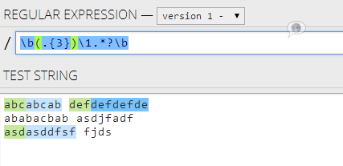
Backreference Constructs

Slide 29
Backreference Constructs
\number – matches the value of a numbered subexpression
\k<name> – matches the value of a named expression
22-12-2015
05/08/2016
\d{2}(-|\/)\d{2}\1\d{4}
=>
References an already captured group by index
22-12-2015
05/08/2016
\d{2}(?<del>-|\/)\d{2}\k<del>\d{4}
=>
Reuses an already captured group by index

Slide 30
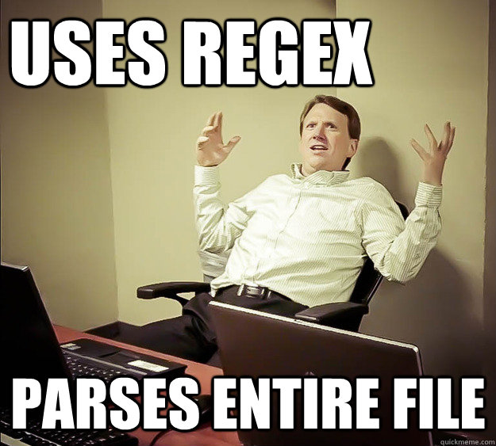
Backreference Constructs
Live Demo

Slide 31
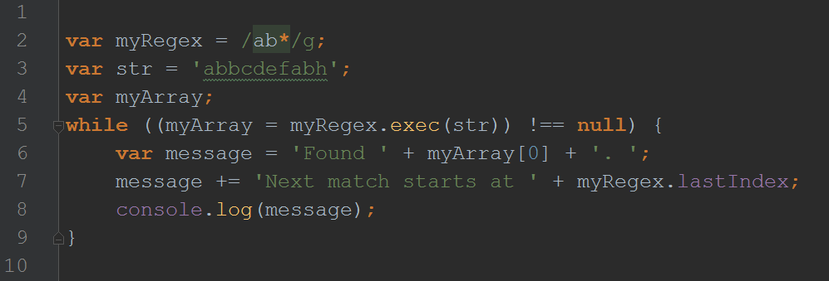
Regular Expressions in JavaScript

Slide 32
Regex in JavaScript
Using a regular expression literal, which consists of a pattern enclosed between slashes
Or calling the constructor function of the RegExp object
var regex = /ab+c/;
var regex = new RegExp("ab+c");

Slide 33
RegExp and String Methods
Regular expressions are used with
The RegExp methods test and exec
The String methods match, replace, search and split
var regex = /quick\s(brown).+?(jumps)/ig;
var result = regex.exec(
'The Quick Brown Fox Jumps Over The Lazy Dog');
var str = 'For more information, see Chapter 3.4.5.1';
var regex = /(chapter \d+(\.\d)*)/i;
var found = str.match(regex);

Slide 34
RegExp Methods
test() - executes a search for a match between a regular expression and a specified string. Returns true or false.
exec() - method executes a search for a match in a specified string. Returns a result array or null.
Is meant to be used in a loop
var regex = /\d/;
var result = regex.test('www.regex101.com');
result[0] = 'Quick Brown Fox Jumps'
result[1] = 'Brown',
result[2] = 'Jumps'
Result is true
var regex = /quick\s(brown).+?(jumps)/ig;
var result = regex.exec(
'The Quick Brown Fox Jumps Over The Lazy Dog');

Slide 35
String Methods
match() - retrieves the matches when matching a string against a regular expression. Returns a result array or null.
search() - search for a match between a regular expression and this String object. Returns the index of the first match of the regular expression inside the string. Otherwise, it returns -1.
var str = 'For more information, see Chapter 3.4.5.1';
var regex = /(chapter \d+(\.\d)*)/i;
var found = str.match(regex);
result[0] = 'For more information, see Chapter 3.4.5.1‘
result[1] = 'For more information, see Chapter 3.4.5.1',
result[2] = ‘.1'
1
var str = 'Returns the index of the first match';
console.log(str.search(/e/));
console.log(str.search(/@/));
-1

Slide 36
String Methods (1)
replace() - returns a new string with some or all matches of a pattern replaced by a replacement.
split() - splits a String object into an array of strings by separating the string into substrings.
Note: To remove empty string you should use .filter()
newStr = 'oranges are round, and oranges are juicy.'
var str = 'Apples are round, and apples are juicy.';
var newStr = str.replace(/apples/gi, 'oranges');
[ '', '23', '2304', '32', '' ]
var str = 'i23need2304only32numbers';
var splittedSting = str.split(/\D+/);

Slide 37
Email Validation – Example
var pattern = /^[\w-]{4,12}@[\w\-]{2,}\.[a-zA-Z]+$/;
var emails = [
"dow_jones@gmail.com",
"spam@nakov",
"JohnSkeet69@1337.org",
"ayy lmao@abv.bg"
];
for (var index in emails) {
console.log(pattern.test(emails[index]));
}
Result:
true
false
true
False`

Slide 38
Helpful Resources
https://regex101.com and http://regexr.com – websites to test Regex using different programming languages
https://developer.mozilla.org/en-US/docs/Web/JavaScript/Guide/Regular_Expressions – a quick reference for Regex from MDN
http://regexone.com – interactive tutorials for Regex
http://www.regular-expressions.info/tutorial.html – a comprehensive tutorial on regular expressions

Slide 39
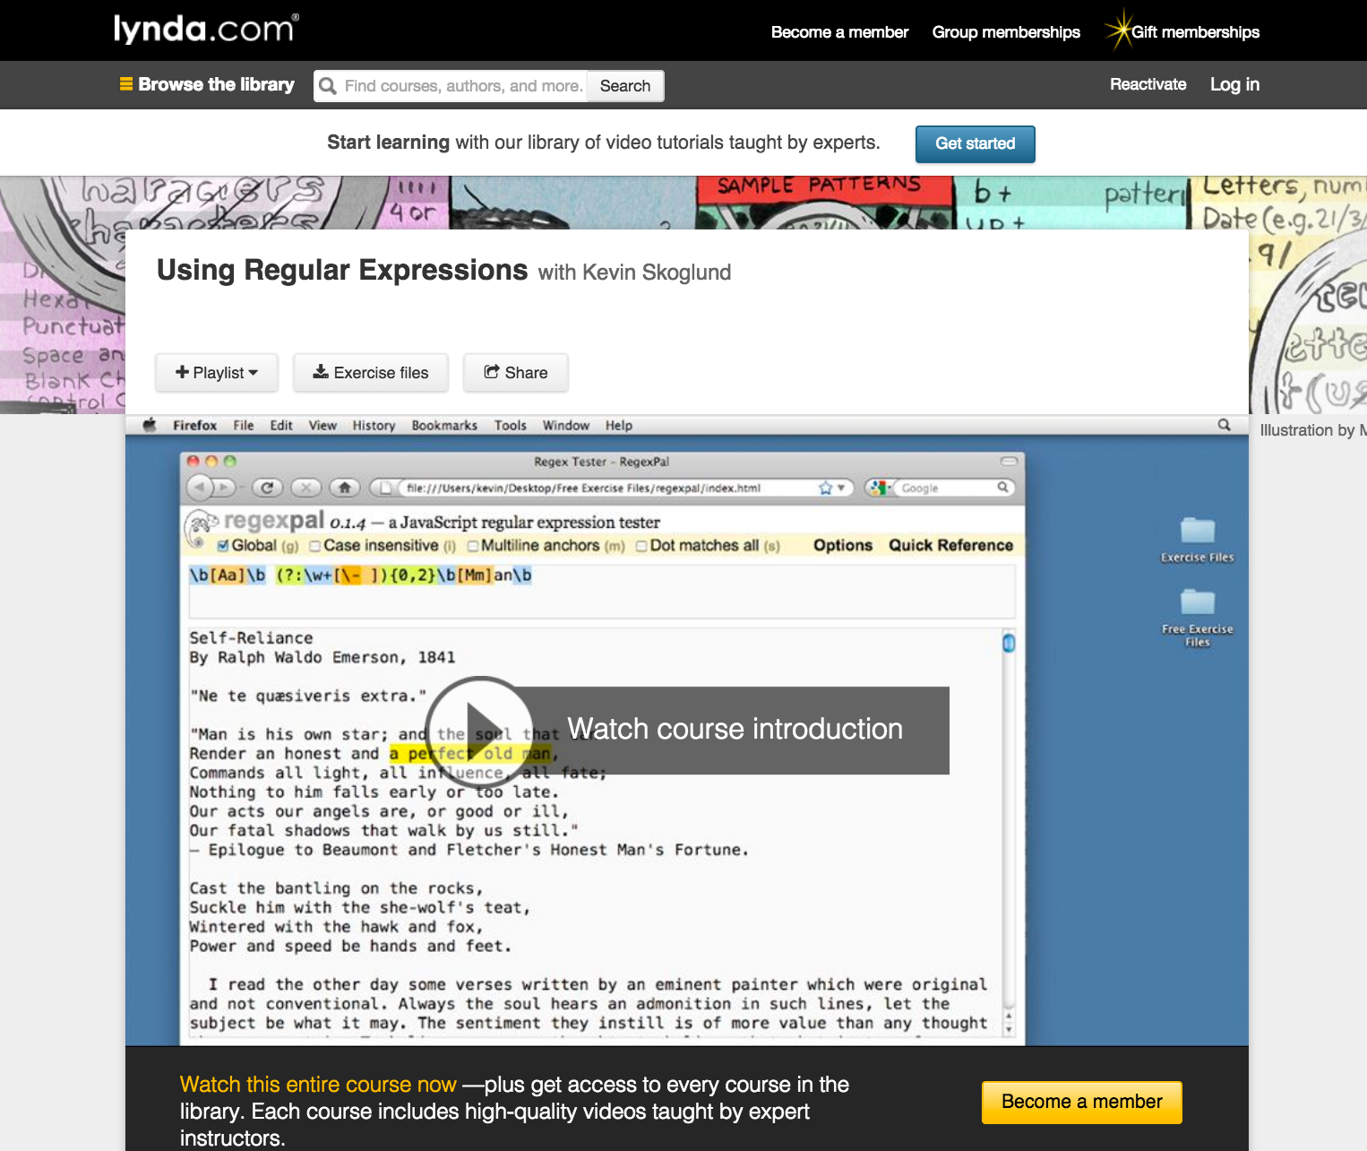
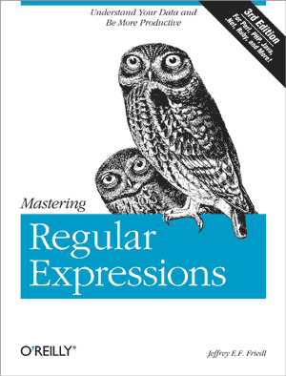
Helpful Resources (2)

Slide 40

Exercises in Class

Slide 41

Summary
Regular expressions describe patterns for
searching through strings of text
Define special characters, operators and
constructs for building complex patterns
Powerful tool for extracting specific data from text or validating strings (e.g. email/username validator)
Regular expressions in JavaScript
RegExp Object – test(), exec()
String – match(), search(), replace(), split()

Slide 42









Regular Expressions in JavaScript
https://softuni.bg/courses/javascript-basics

Slide 43

License
This course (slides, examples, demos, videos, homework, etc.) is licensed under the "Creative Commons Attribution-NonCommercial-ShareAlike 4.0 International" license
Attribution: this work may contain portions from
"C# Fundamentals – Part 1" course by Telerik Academy under CC-BY-NC-SA license
"C# Fundamentals – Part 2" course by Telerik Academy under CC-BY-NC-SA license

Slide 44





Free Trainings @ Software University
Software University Foundation – softuni.org
Software University – High-Quality Education, Profession and Job for Software Developers
softuni.bg
Software University @ Facebook
facebook.com/SoftwareUniversity
Software University @ YouTube
youtube.com/SoftwareUniversity
Software University Forums – forum.softuni.bg

